Slide 1

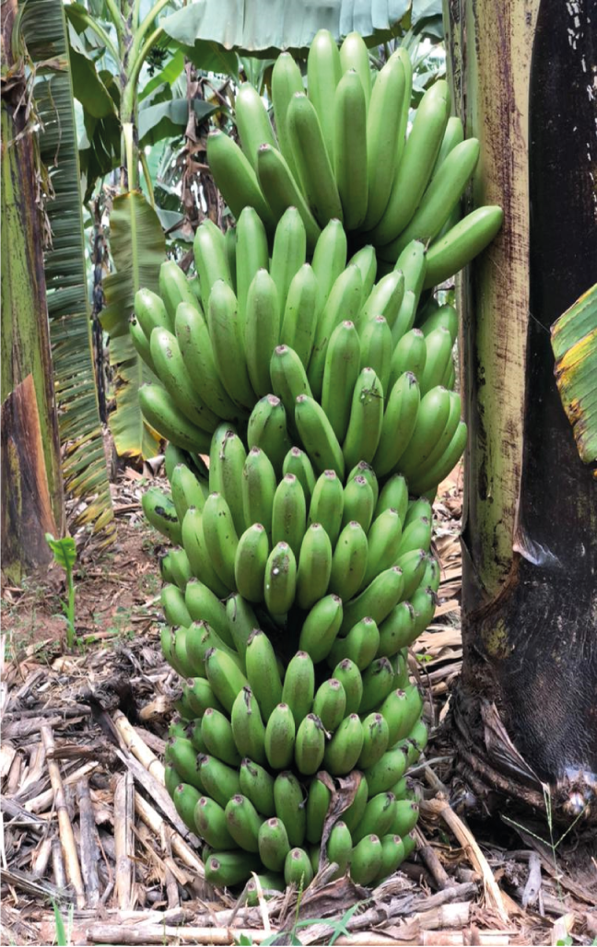
NARO-IITA RELEASED BANANA VARIETY
KABANA 6H (NARITA 7/M9/Kiwangaazi )
Year of release: 2010
Best for: Cooking
Special Attributes:
Tolerant to black Sigatoka (leaf spot disease).
Tolerant to banana weevils (insects that reduce plantation longevity).
Tolerant to nematodes (invisible worms that cause root rotting and toppling.
Bunch weight 57.7kg
Yield potential 60 tons/ha/year
Acceptability level at 3.5/6
Economic return ha/yr Ugx 18,000,000

