Slide 1

Claire
Influence of the seed treatment on the yield
Trial carried out in the long rainy season 2024 by ICM SOLUTIONS LTD in Sorghum
100 µm
Trial locations: County Siaya and Kakamega in Western Kenya
Randomized Complete Block Design
Plot size: 2.00m x 5.00m
Spacing between the rows: 75cm
Spacing between the plants: 10cm
Variety: Gadam
Number of replications: 4
Planting: April 11th and 12th , 2024
Harvest: July 25th and 27th , 2024

Slide 2
Claire
Influence of the seed treatment on the yield
Trial carried out in the long rainy season 2024 by ICM SOLUTIONS LTD in Sorghum
100 µm

Slide 3
Claire
Influence of the seed treatment on the yield
Trial carried out in the long rainy season 2024 by ICM SOLUTIONS LTD in Sorghum
100 µm

Slide 4
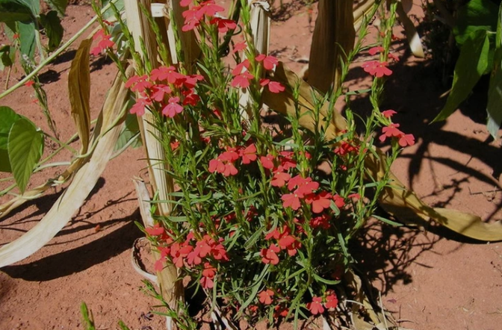
Claire
Influence of the seed treatment on the yield
100 µm
Striga asiatica on maize

Slide 5
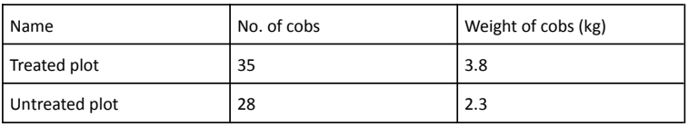
Claire
Influence of the seed treatment on the yield
100 µm
Trial to check the efficacy against Striga asiatica in maize
So far, we only carried out one trial.
The trial was carried out in November 2023 in Kilifi North (coastal region of Kenya)
Variety: DK 777
Application rate: 8g per kg of seed
Cut out of the report

